Slide 1
Empreendedorismo em ciências
2019/2020
1º CICLO DE ESTUDOS
AULA 2
23 e 26 SET 2019
Helena Vieira
Copyright ©

Slide 2
SUMÁRIO
Innovation and it’s diverse models:
Innovation Vs Invention
Radical Vs Incremental Innovation
Open Vs Closed innovation
Other innovation models
Intellectual Property and how to protect knowledge
IR regulation of ULisboa

Slide 3
INNOVATION
Innovation is people creating value by implementing new ideas
Innovation is something different that has impact
Innovation concerns the search for and the discovery, experimentation, development, imitation and adoption of new products, new processes and new organizational set ups
Innovation is the conversion of knowledge and ideas into a benefit, which may be for commercial use or for the public good; the benefit may be new or improved products, processes or services

Slide 4
INNOVATION
INNOVATION is NOT TECHNOLOGY BASED
INNOVATION ≠ CREATIVITY
INNOVATION ≠ NOT BEEN DONE BEFORE!

Slide 5
INVENTION VS INNOVATION
WHAT IS THE MAIN DIFFERENCE?

Slide 6
INVENTION
A system of intertwined pieces of metal that is joined up by another larger metal piece in a successive way, up and down.
An electric pump linked to a suction system can push in objects and small particles from the environment
A system made of aluminum with turns that holds paper
Production of an artificial circular double stranded DNA containing an origin of replication, a polylinker and an antibiotic resistant gene
An aluminum foil covered capsule for moisture and humidity tightness for coffee storage.
Isolation of a fluorescent protein from a water mollusk.

Slide 7
INNOVATION
INVENTION
+
EXPLOITATION
=

Slide 8
INNOVATION
NO IMPACT
NO

Slide 9
INNOVATION
LEONARDO DA VINCI
VS
THOMAS EDISON

Slide 10
INNOVATION
GENIUSES
Da Vinci – ability to see future, designed & created models that were never implemented in his time (he was a thinker, not a doer!)
Thomas Edison – he implemented his ideas – light bulb; phonograph; motion-picture industry – and they had impact because he was a doer.

Slide 11
INVENTION
A system of intertwined pieces of metal that is joined up by another larger metal piece in a successive way, up and down.
An electric pump linked to a suction system can push in objects and small particles from the environment
A system made of aluminum with turns that holds paper
Production of an artificial circular double stranded DNA containing an origin of replication, a polylinker and an antibiotic resistant gene
An aluminum foil covered capsule for moisture and humidity tightness for coffee storage.
Isolation of a fluorescent protein from a water mollusk.

Slide 12
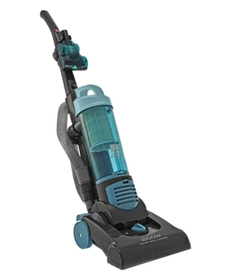
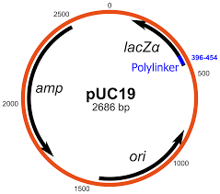
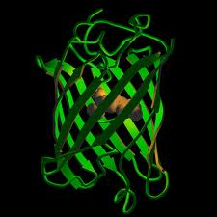
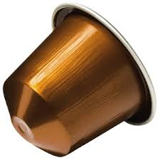
INNOVATION

Slide 13
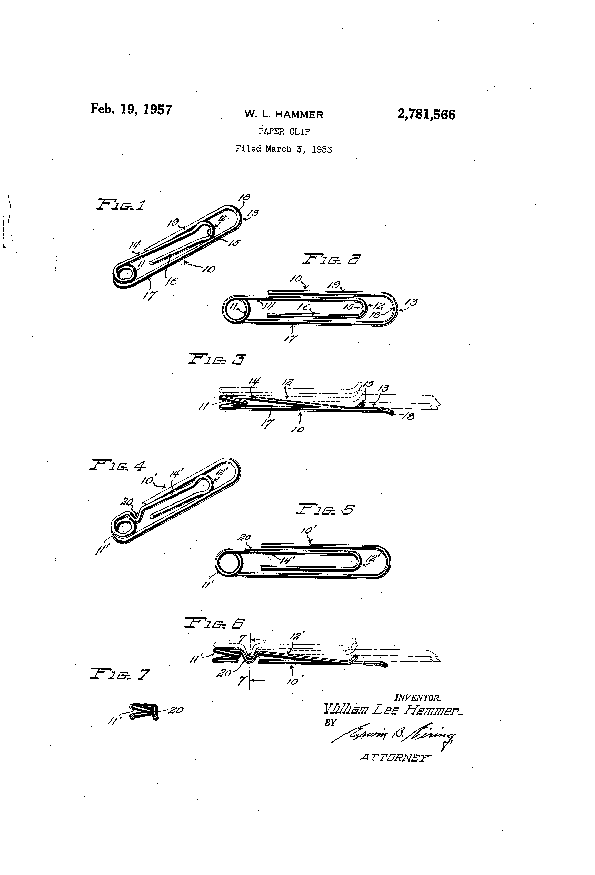
INVENTION

Slide 14
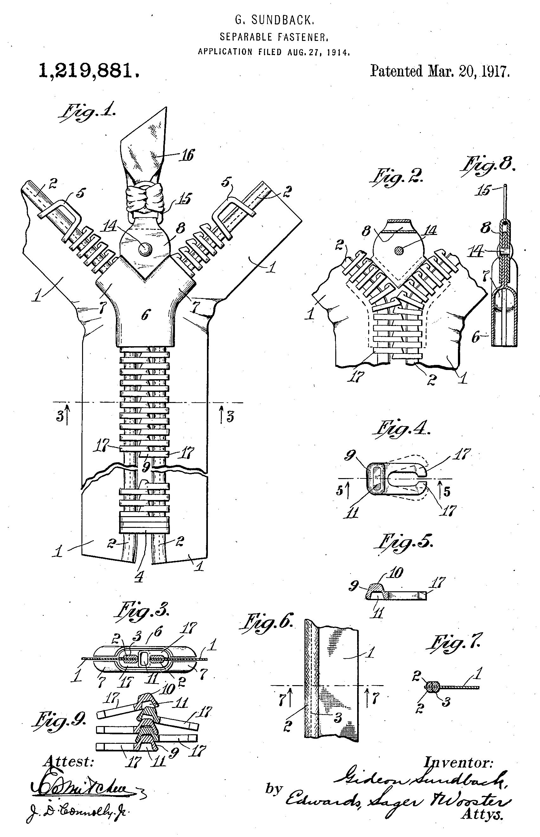
INVENTION

Slide 15
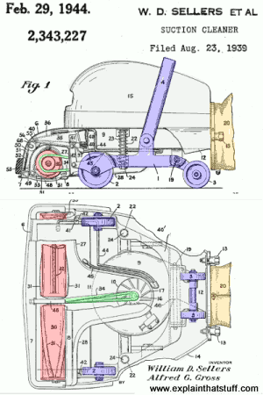
INVENTION

Slide 16
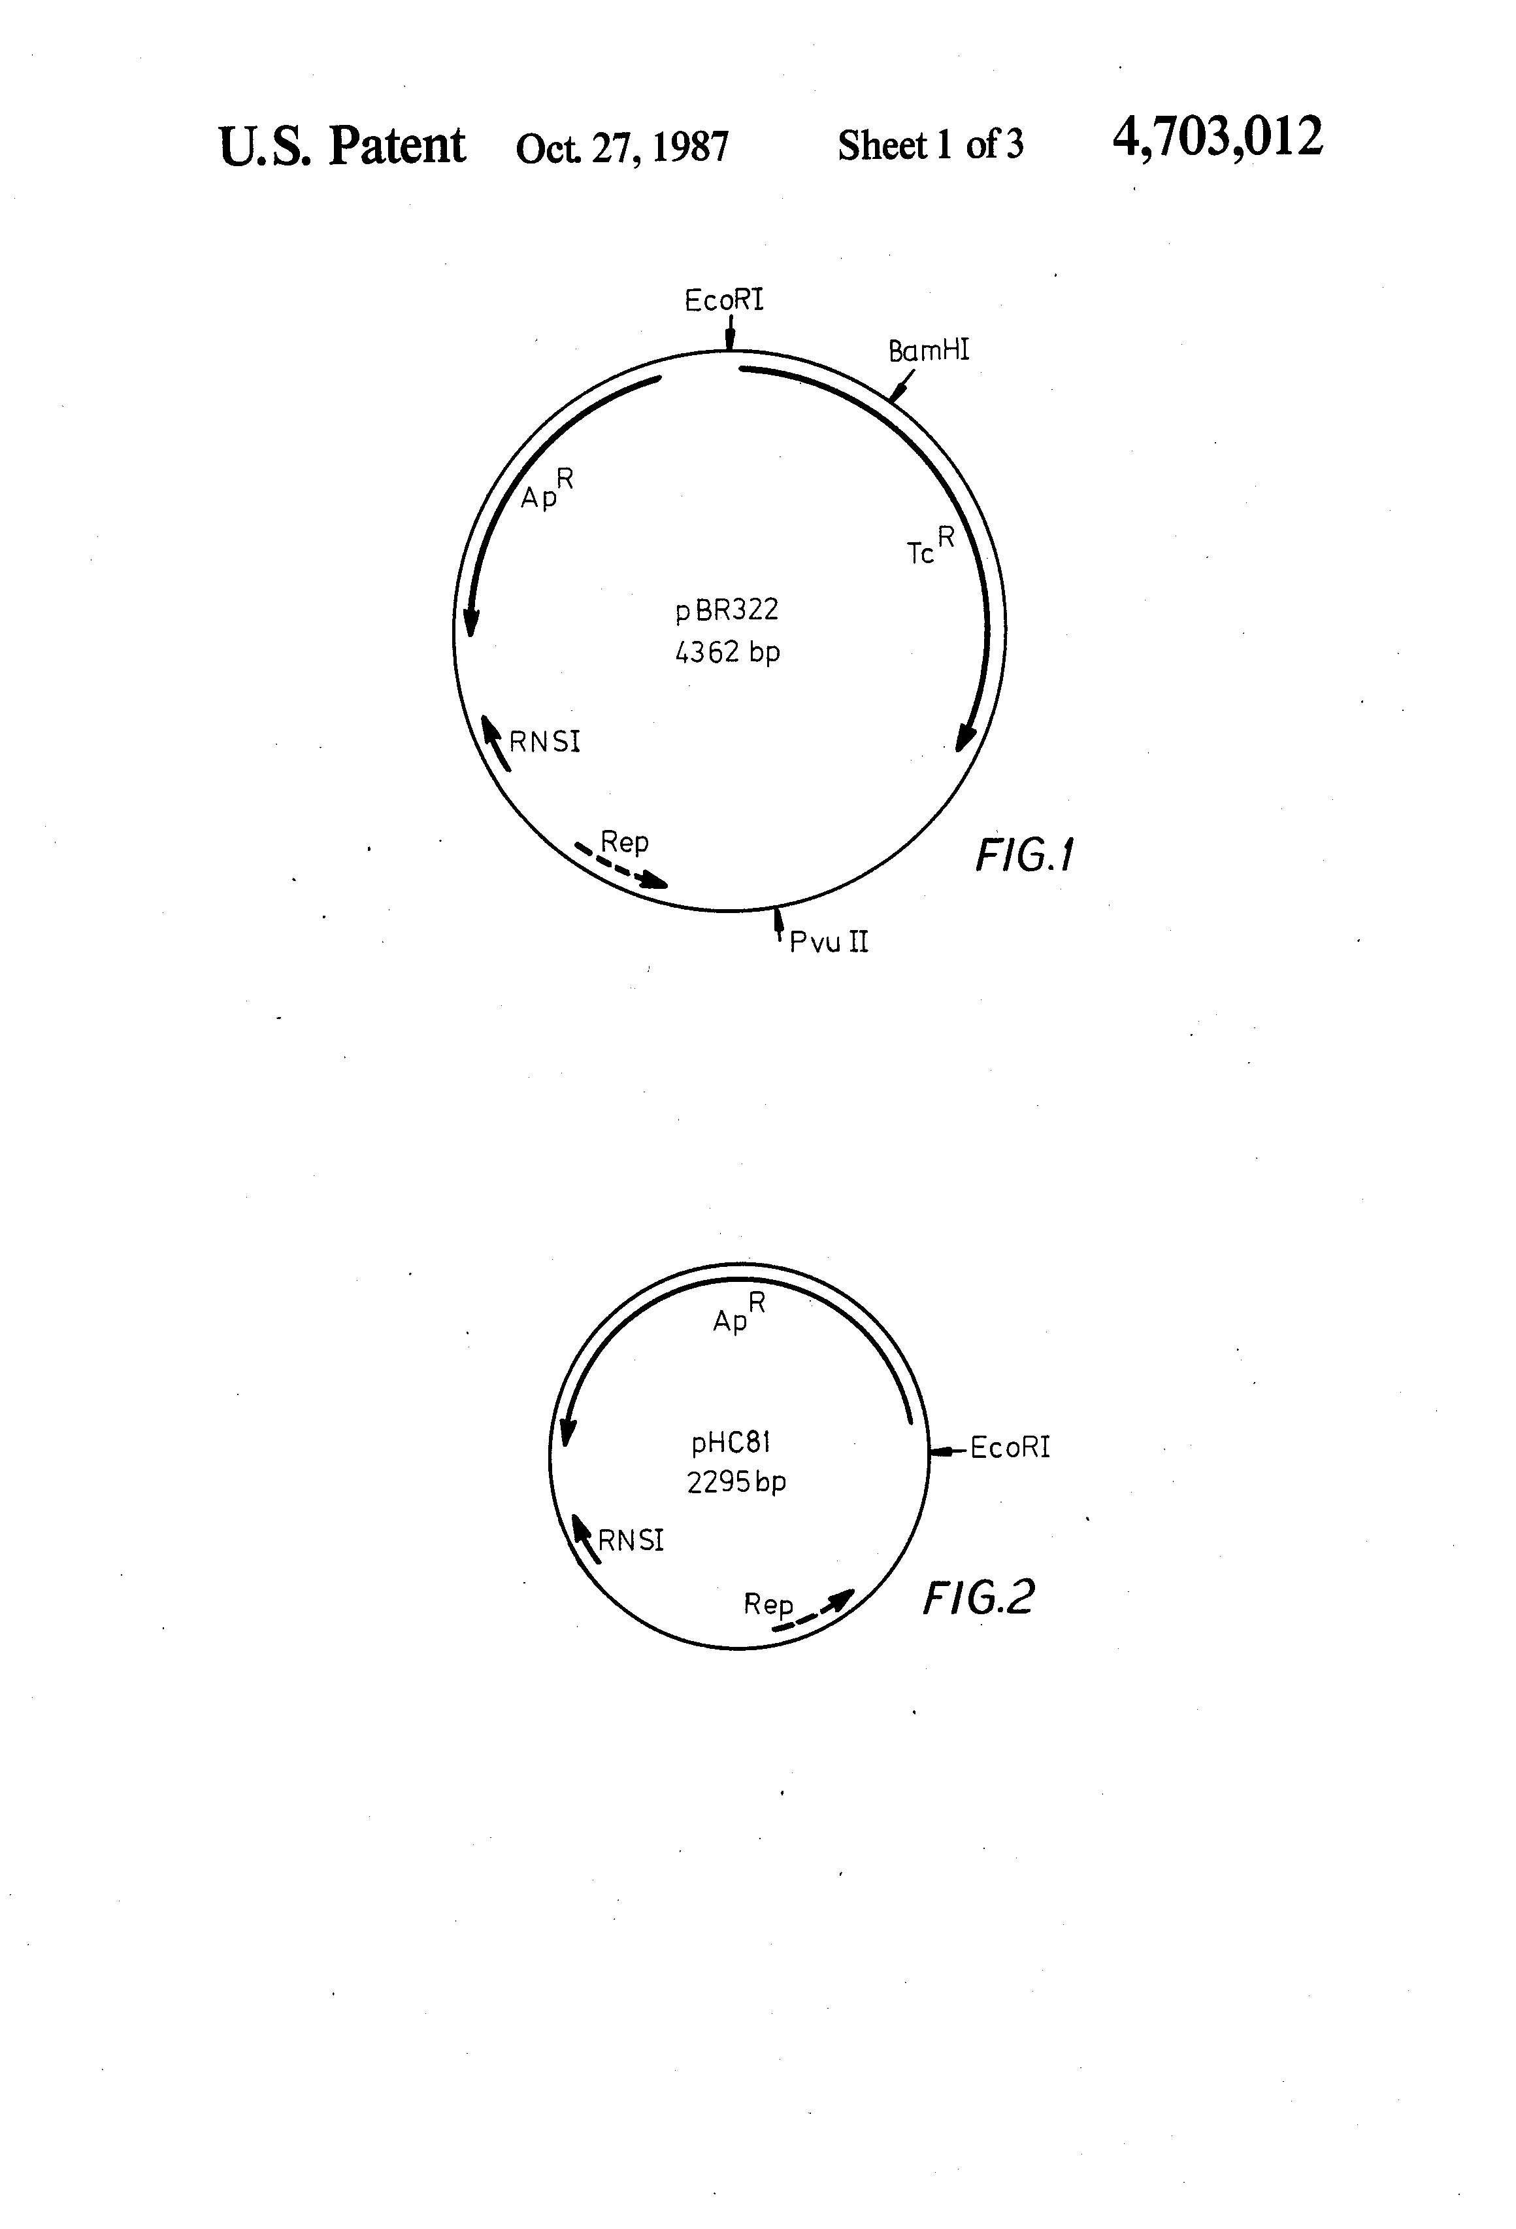
INVENTION

Slide 17
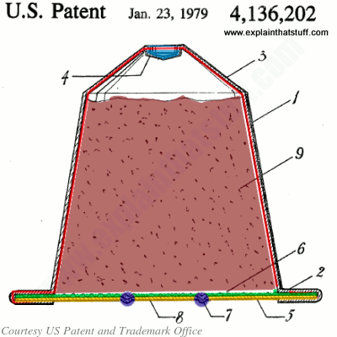
INVENTION

Slide 18
INNOVATING TAKES TIME!

Slide 19
INNOVATION
Incremental innovation seeks to improve the systems that already exist, making them better, faster, cheaper. This is sometimes called "Market Pull" Innovation.
Radical innovation is more focused on new technologies, new business models and breakthrough businesses. This is sometimes called "Technology Push" Innovation

Slide 21
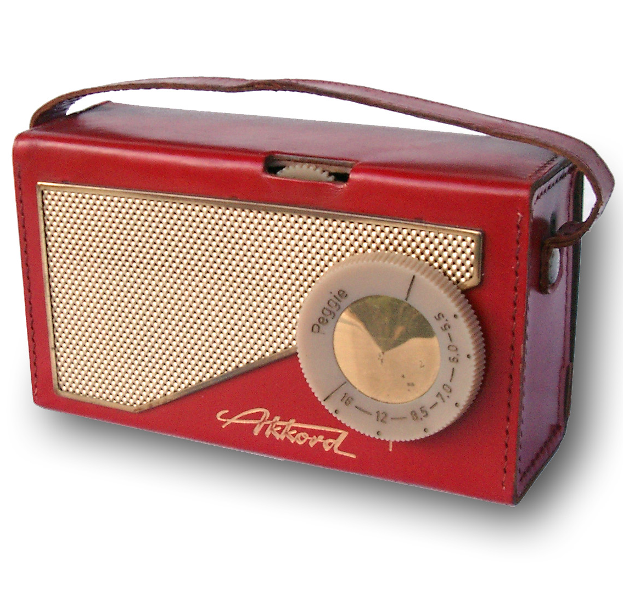
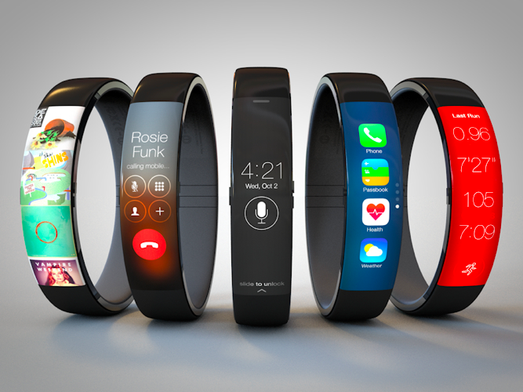
RADICAL INNOVATION

Slide 23
INNOVATION
Open innovation valuable ideas come from inside or outside the company and can go to market from inside or outside the company as well.
Closed innovation valuable ideas for a company come from within this company and go to market from within this same company (centralized R&D).

Slide 24
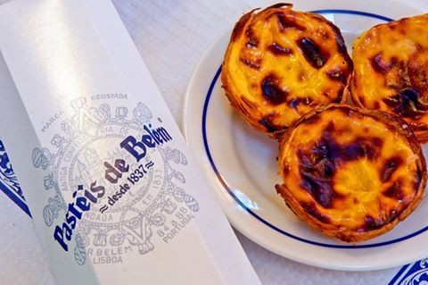
CLOSED INNOVATION

Slide 25
OPEN INNOVATION
Notes:
LEGO - The ‘open’ in open innovation can reveal itself in a number of ways. For example, it can refer to overcoming the “not invented here” syndrome by welcoming external input. Openness is “outside in” when it makes greater use of external brainpower for its innovations. There is also another kind of openness in which a company opens up its ideas and technologies to be used by other companies, even competitors. Lego Mindstorms is a classic example of the “outside in” open innovation model where the company has allowed customers to create designs.
GALP PLUMA – designed by portuguese to the Portuguese

Slide 26
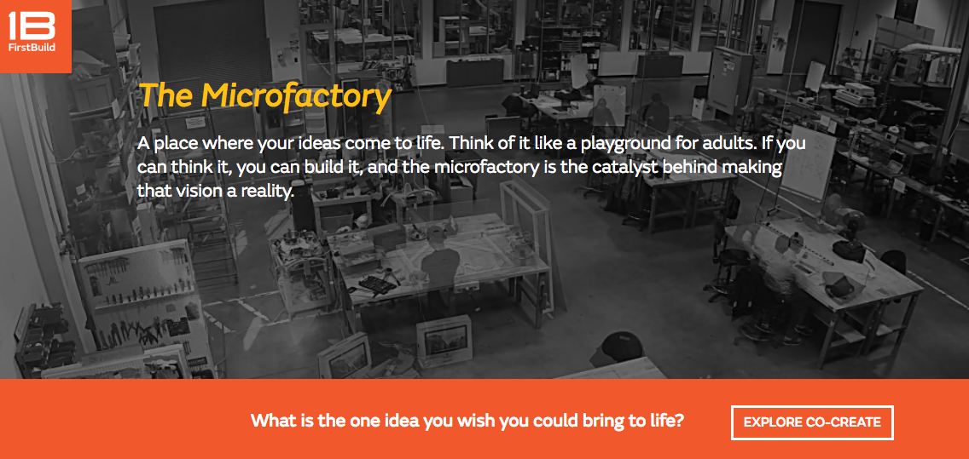
OPEN INNOVATION

Slide 27
OPEN INNOVATION

Slide 28
100 USES EXERCISE
Divide into 2 groups
Each group must in 10 min come up with a list of 100 different uses for the item in their selected card.

Slide 29
TWO BUCKETS EXERCISE
Divide in groups of 3-5
Each group:
Pick a card from bucket A (Brands)
+
Pick a card from bucket B (needs)
Challenge: You work for the company on the A card, and they now require you to develop a product for them that is on the B card. Present your solution.
Notes:
Two Buckets
• Students form teams of three to five. Each
team randomly chooses an index card from
each of two buckets. One set of cards has
major brand names (including international
brands). One set has product categories
(including developing nations’ needs). The
instructor opens with “You work for the
company on the one card, and they now
require you to develop a product for them
that is on the other card.” The groups are
given five to seven minutes to develop
the product’s features, benefits, target
audience, and perhaps promotional ideas.
One spokesperson from each team briefly
presents to the class while the instructor
records their ideas on the board.
• Lesson: Forced association (combining
disparate ideas) is a helpful and practical
way to get ideas for potential innovation,
and a skill that can be developed in
students.

Slide 30
INNOVATION
Product / Service
Process
Business model
Strategy

Slide 31
INVENTIONS & PROTECTION
Protection guarantees some sort of exclusivity
Must we Protect EVERYTHING?

Slide 32
Intellectual Property
Intellectual Property (IP) protection guarantees the inventor of a new process or product to benefit from, or allow others to take profit from, the exploitation of that IP, either financially or other, preventing the possibility of unfair use of it by third parties.

Slide 33
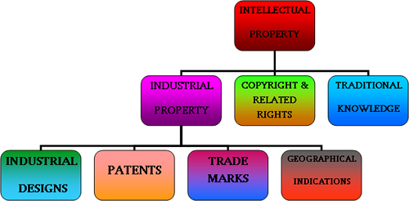

Slide 34
PATENTS
A patent is a monopolist right given to the inventor for a period of up to 20 years, depending on national laws, that is restricted to the details and claims defined in the patent’s document.
Only new, inventive and industrially suitable inventions can be patented.

Slide 35
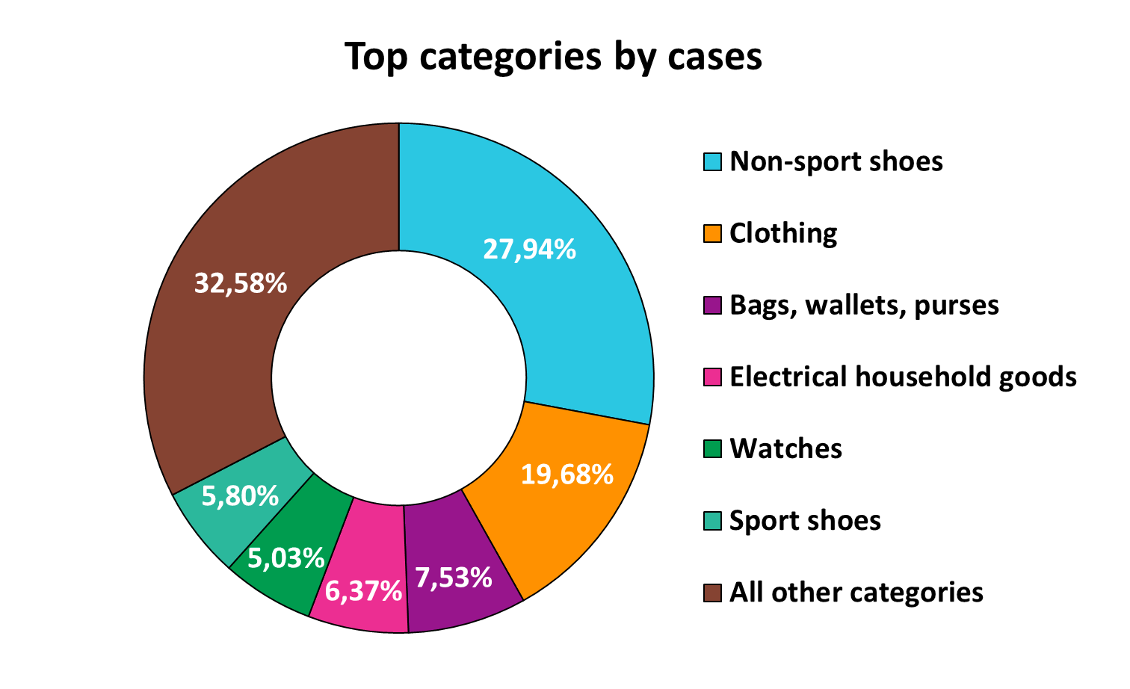

Slide 36
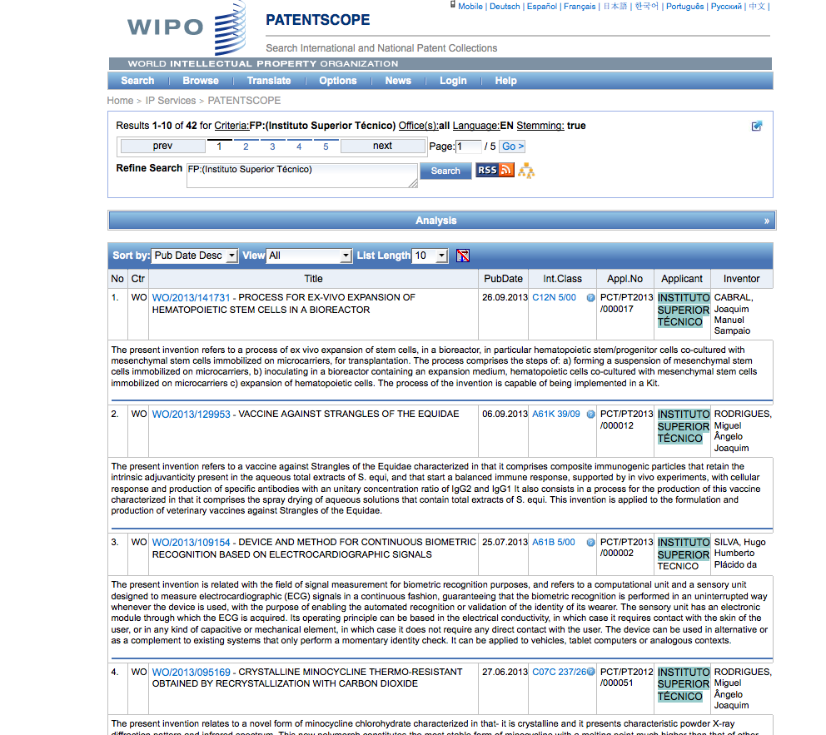

Slide 37
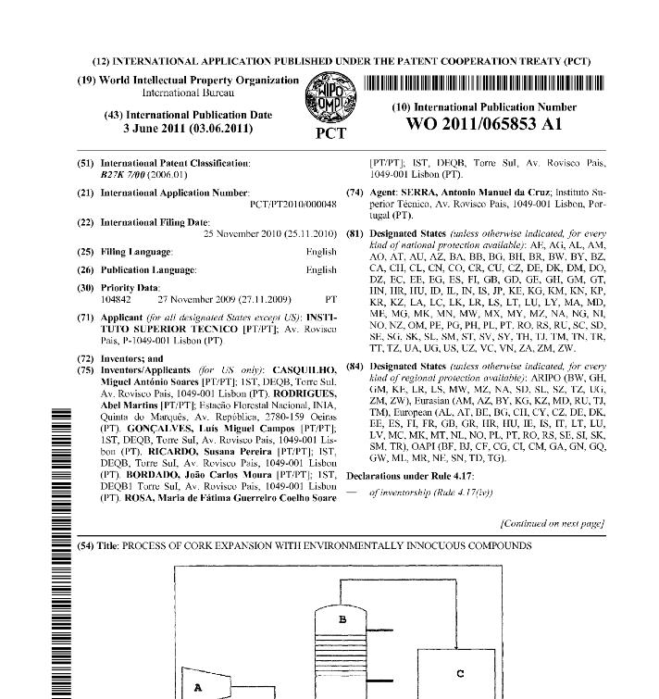
PATENTS

Slide 38
PATENTS
What can NOT be patented:
Live organisms
Original DNA sequences/genes
Anything in nature
Software
What CAN be patented:
Uses/production methods of live organisms
Modified/recombinant DNA sequences, vectors and methods
Anything that is modified from nature
Usage of a code/algorithm

Slide 39
PATENTS DATABASES
www.inpi.pt
www.wipo.com
https://www.epo.org/index.html

Slide 40
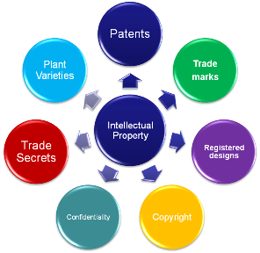

Slide 41
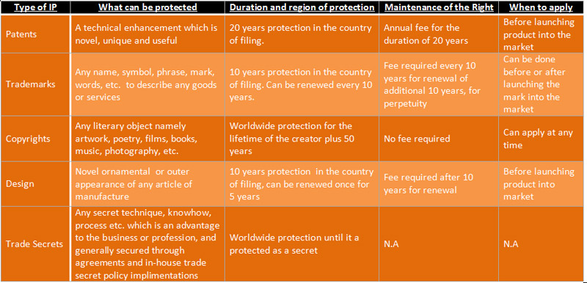

Slide 42
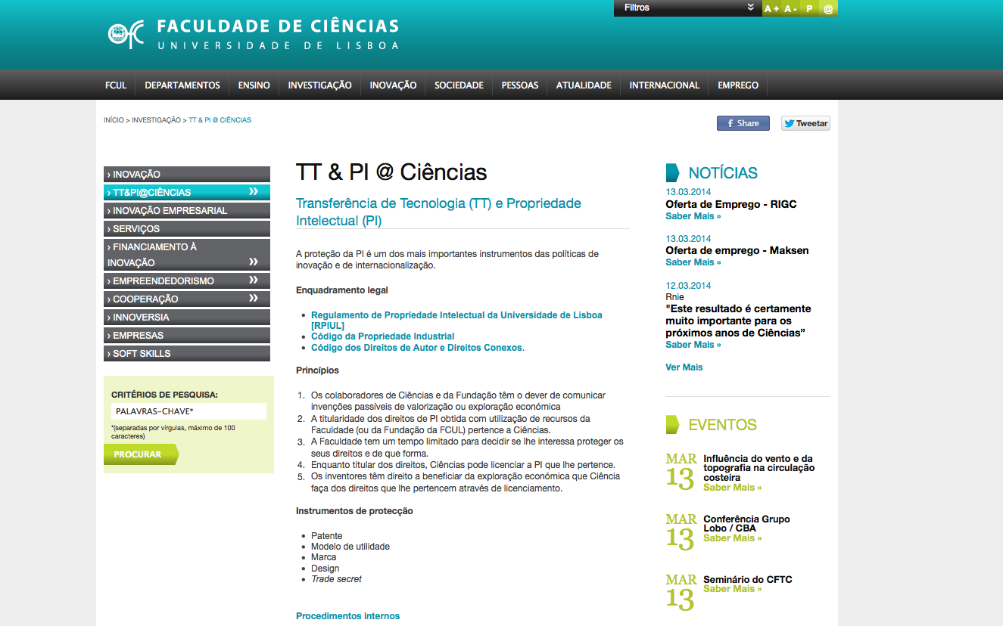
The IP CODE of ULISBOA
http://www.fc.ul.pt/pt/pagina/386/tt-pi-ciências

Slide 43
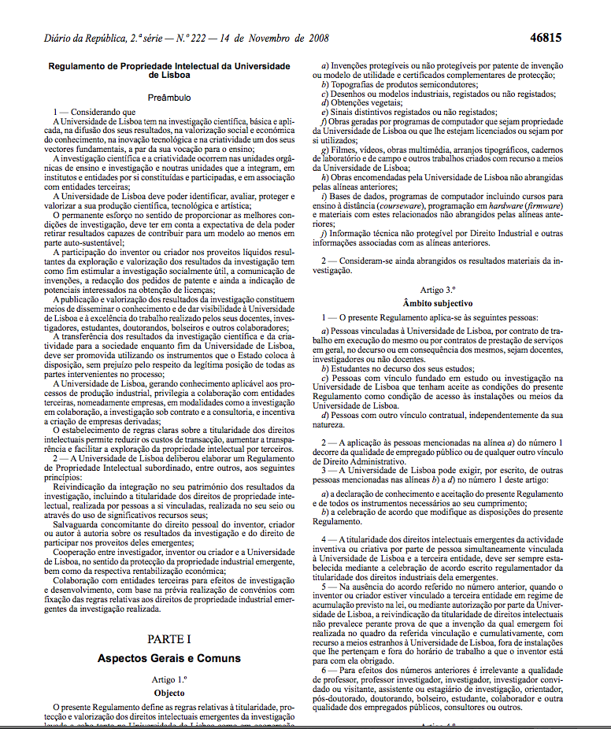
The IP CODE of ULISBOA
http://www.fc.ul.pt/pt/pagina/386/tt-pi-ciências

Slide 44
The IP CODE of ULISBOA
KEY POINTS
All the rights over R&D performed in UL belong to UL
The inventor has the right to be recognised as so in any IP piece or communication (or not if he/she desires so)
The inventor shall communicate the invention to UL (Via TT@UL) maximum 1 month after invention was made
If UL has no interest in protecting the IP, it can give partial or full rights to inventor
http://www.fc.ul.pt/pt/pagina/386/tt-pi-ciências

Slide 45
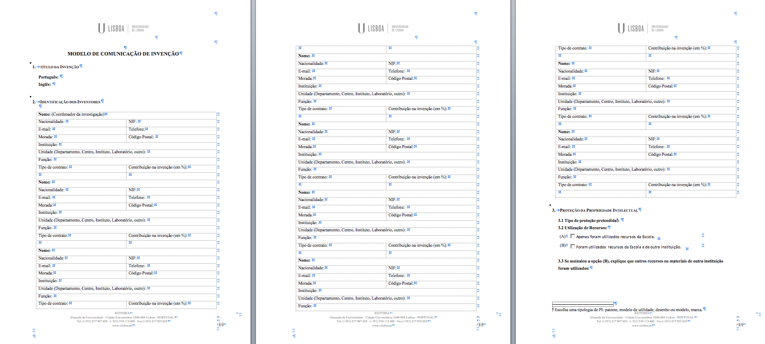
The IP CODE of ULISBOA
1st Step– Invention communication
http://www.fc.ul.pt/pt/pagina/386/tt-pi-ciências

